Slide 1

Team name : “ FinTrack ”
Portfolio management system
Presented by -
Kasturi Kulkarni
Harshada Atalkar
Rama Labhe

Slide 2

I don’t even
know whether
I’m growing
or losing money
No idea about investments ?
Assests scattered ?
No returns ?!
Aarohi’s desk

Slide 3


To solve Aarohi’s problem,
One-stop financial management tool
Assets, investments, tracking integrated
No switching between platforms
Manage portfolio with ease
Saves time, boosts clarity

Slide 4


System workflow
Express Middleware -
Processes request
Frontend sends
API request
Matches endpoint , calls controller
Executes SQL via databse
Data is
Retrived
Client
receives
data
Formats
JSON
response

Slide 5





Database design
Financial goals
Assests
Transactions

Slide 6
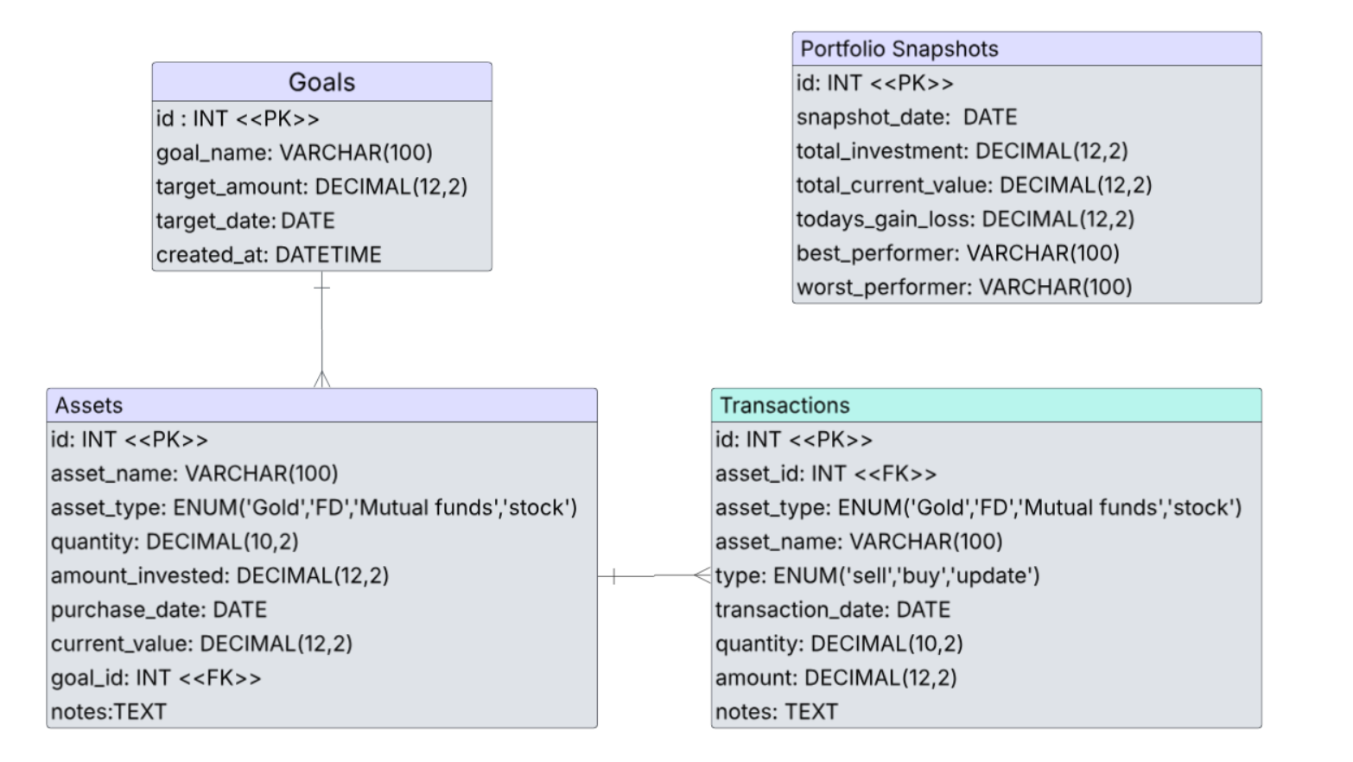
ER Diagram

Slide 7







To reach this stage we collaborated using :

Slide 8


Slide 9


